Slide 1
Welcome To Workers on Site
Juan Davila

Slide 2
Problem to Solve
The overall need of the application is that business owners have a hard time quantifying a job site with the estimation of a proposal, materials and workers on site.
Allow a business user to add sites that are on their scope of work and be able to assign workers to a site from a list of workers that shows them what workers are assigned to a specific site.

Slide 3
App Goals
Allow a manager to add workers.
Allow a manager to add sites.
Allow the manager to see what workers are assigned to a site.

Slide 4
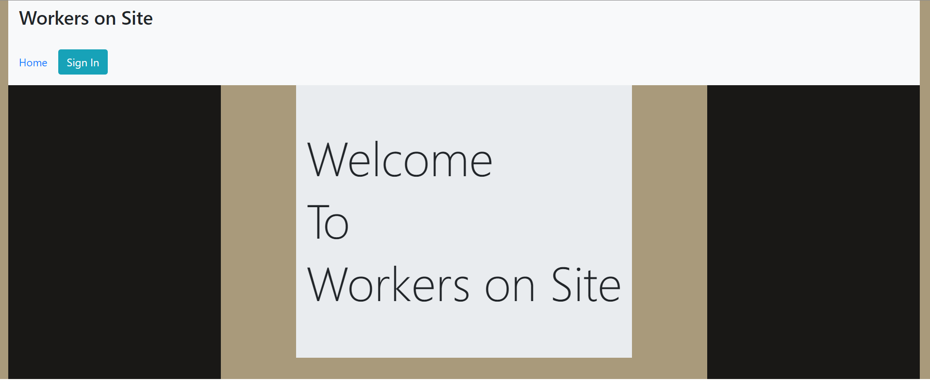
Demo Time

Slide 5
Lessons Learned
Don’t underestimate the complexity of the problem.
Ask for help sooner than later.
Keep moving forward, solve what you can.
Test and re-test what your functions are doing.

Slide 6
Tech Stack
React
Javascript
HTML
Firebase
Netlify
Axios

Slide 7
Thanks
Casey => (Motivation and stay on track / deployment)
Dani => (HTML / flexbox / wireframes)
Honey-Rae => (Helping with debugging)
Lindsey => (Checkboxes)
Gabrielle => (Warning checker)
Trinity / Aja => (Well explained concepts and patience)
Dr. T. => (Thank you for keep pushing forward and believing in us!)

